Slide 1
Final Exam Review
INFO 6210– Data Management and Database Design

Slide 2
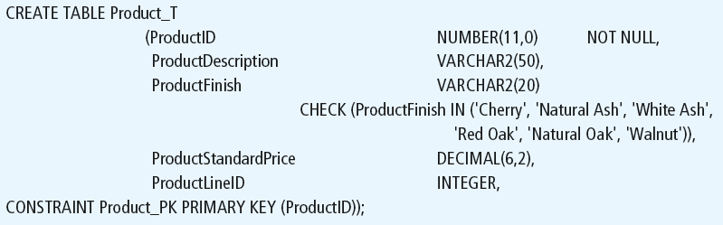
Defining attributes and their data types

Slide 3
Non-nullable specification
Primary keys can never have NULL values
Identifying primary key

Slide 4
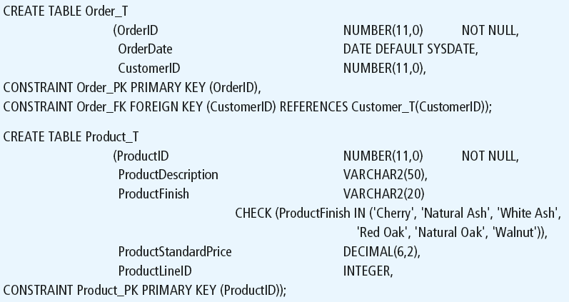
Controlling the values in attributes
Default value
Domain constraint

Slide 5
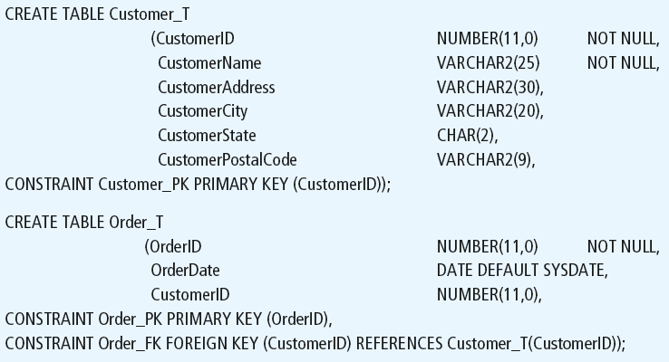
Identifying foreign keys and establishing relationships
Primary key of parent table
Foreign key of dependent table

Slide 6



Insert Statement
Adds one or more rows to a table
Inserting into a table
Inserting a record that has some null attributes requires identifying the fields that actually get data
Inserting from another table
Notes:
Have students perform this function

Slide 7
Delete Statement
Removes rows from a table
Delete certain rows
DELETE FROM CUSTOMER WHERE CUSTOMERSTATE = ‘HI’;
Delete all rows
DELETE FROM CUSTOMER

Slide 8

Update Statement
Modifies data in existing rows

Slide 9
UPDATE SET based
UPDATE Charges
SET TotalCharges = CurrentCharges + Taxes

Slide 10
SELECT Statement
Used for queries on single or multiple tables
Clauses of the SELECT statement:
SELECT
List the columns (and expressions) that should be returned from the query
FROM
Indicate the table(s) or view(s) from which data will be obtained
WHERE
Indicate the conditions under which a row will be included in the result
GROUP BY
Indicate categorization of results
HAVING
Indicate the conditions under which a category (group) will be included
ORDER BY
Sorts the result according to specified criteria

Slide 11
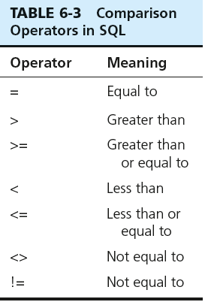

SELECT Example
Find products with standard price less than $275
Table 6-3: Comparison Operators in SQL
Notes:
Show the operators
Go back to SSMS and query the database!

Slide 12
SELECT Example Using a Function
Using the COUNT aggregate function to find totals
SELECT COUNT(*) FROM ORDERLINE_T
WHERE ORDERID = 1004;
Note: with aggregate functions you can’t have single-valued columns included in the SELECT clause, unless they are included in the GROUP BY clause

Slide 13
Aggregate Function syntax
SELECT expression1, expression2, ... expression_n,
aggregate_function1 (aggregate_expression),
aggregate_function2 (aggregate_expression)
FROM tables
[WHERE conditions]
GROUP BY expression1, expression2, ... expression_n
[ORDER BY expression [ ASC | DESC ]];
Notes:
Expression1 , 2 , 3 are non aggregates.
You may have more than one aggregate functions in a SELECT expression
All non aggregate expressions must included in the group by clause

Slide 14
Aggregate Functions
SUM -> summation
MIN -> to find the lowest or minimum
MAX -> to find the highest or maximum
AVG -> mean
COUNT -> how may records
Notes:
There are many others, depending on the DBMS system you are using.
STD Deviation of a population
STD Devation of a sample
VAR of Popluation
VAR of a population

Slide 15
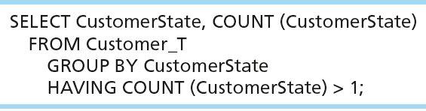
SELECT Example– Qualifying Results by Categories Using the HAVING Clause
For use with GROUP BY
Like a WHERE clause, but it operates on groups (categories), not on individual rows. Here, only those groups with total numbers greater than 1 will be included in final result.

Slide 16
Using and Defining Views
Views provide users-controlled access to tables
Can be used for reporting
Base Table–table containing the raw data
Dynamic View
A “virtual table” created dynamically upon request by a user
No data actually stored; instead data from base table made available to user
Based on SQL SELECT statement on base tables or other views
Notes:
Materialized views in Oracle, they are called Indexed views in SQL Server which are based on clustered index

Slide 17
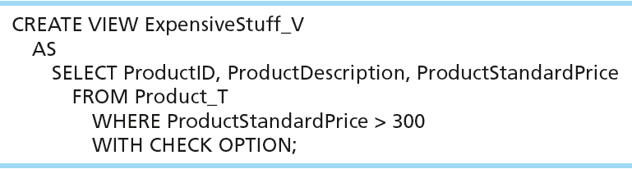
Sample CREATE VIEW
View has a name
View is based on a SELECT statement
Notes:
Materialized views

Slide 18
Practical Version: Four Types of JOINS
INNER JOIN
OUTER JOIN
LEFT OUTER JOIN
RIGHT OUTER JOIN
FULL JOIN

Slide 19
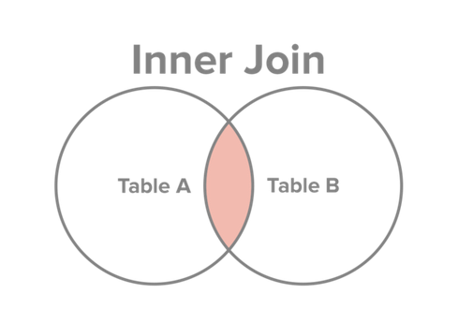
INNER JOIN
Select all records from Table A and Table B, where the join condition is met.
http://www.sql-join.com/sql-join-types/

Slide 20
INNER JOIN SQL
SELECT c. CustomerID, c.CustomerName, o.OrderID
FROM Customer c INNER JOIN ORDER AS o ON c.CustomerID = o.CustomerID
Key word INNER is optional:
SELECT c. CustomerID, c.CustomerName, o.OrderID
FROM Customer c JOIN ORDER AS o ON c.CustomerID = o.CustomerID
Notes:
This query returns only customers that have orders,
If a customer doesn’t have orders it doesn’t show up

Slide 21
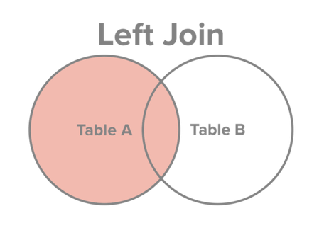
JOINS: LEFT OUTER JOIN
Select all records from Table A, along with records from Table B for which the join condition is met (if at all).
http://www.sql-join.com/sql-join-types/

Slide 22
LEFT OUTER JOIN SQL
SELECT c. CustomerID, c.CustomerName, o.OrderID
FROM Customer c LEFT OUTER JOIN ORDER AS o ON c.CustomerID = o.CustomerID
Key word OUTER is optional:
SELECT c. CustomerID, c.CustomerName, o.OrderID
FROM Customer c LEFT JOIN ORDER AS o ON c.CustomerID = o.CustomerID
Notes:
This query returns only customers that have orders,
If a customer doesn’t have orders it doesn’t show up

Slide 23
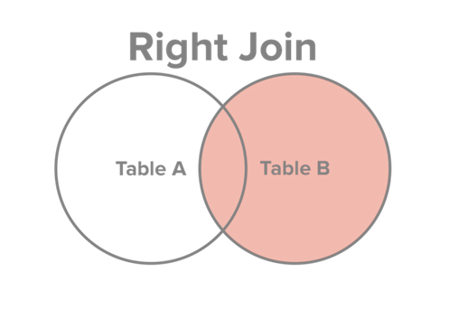
JOINS: RIGHT OUTER JOIN
Select all records from Table B, along with records from Table A for which the join condition is met (if at all).
http://www.sql-join.com/sql-join-types/

Slide 24
RIGHT OUTER JOIN SQL
SELECT c. CustomerID, c.CustomerName, o.OrderID
FROM Order_T o RIGHT OUTER JOIN Customer_T c ON c.CustomerID = o.CustomerID
Key word OUTER is optional:
SELECT c. CustomerID, c.CustomerName, o.OrderID
FROM Order_T o RIGHT JOIN Customer_T c ON c.CustomerID = o.CustomerID
Notes:
This query returns only customers that have orders,
If a customer doesn’t have orders it doesn’t show up

Slide 25
Multiple Table JOIN
SELECT c.CustomerID, c.CustomerName, c.CustomerAddress, c.CustomerCity, c.CustomerState, c.CustomerPostalCode, o.OrderID, o.OrderDate, ol.OrderedQuantity, p.ProductDescription, p.StandardPrice, ( ol.OrderedQuantity*p.ProductStandardPrice)
FROM Customer c JOIN Order o ON c.CustomerID = o.CustomerID
JOIN OrderLine ol ON o.OrderID = ol.OrderID
JOIN Product p ON ol.ProductID = p.ProductID
WHERE o.OrderID = 1006

Slide 26
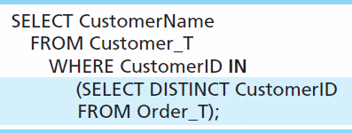
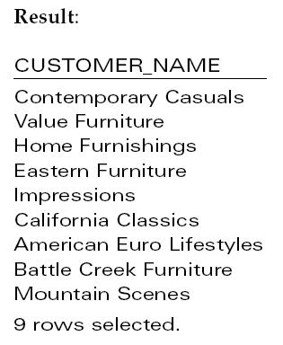
Subquery Example
Show all customers who have placed an order
The IN operator will test to see if the CUSTOMER_ID value of a row is included in the list returned from the subquery
Subquery is embedded in parentheses. In this case it returns a list that will be used in the WHERE clause of the outer query
Notes:
Subquery is what is in parenthesis.
In this example, the subquery can run by itself and return a result. Subquery is always in parenthesis
The subquery will return a list of all distinct or unique customer ID, and then that result is used to filter the outer query
This is a non-correlated subquery

Slide 27
Correlated vs. Noncorrelated Subqueries
Noncorrelated subqueries:
Do not depend on data from the outer query
Execute once for the entire outer query
Correlated subqueries:
Make use of data from the outer query
Execute once for each row of the outer query
Can use the EXISTS operator
Notes:
Noncorrelated subqueries:
Do not depend on data from the outer query – just like we saw in the prior example the subquery could run by itself and you will see a list of customer ids
Execute once for the entire outer query – only executves
Correlated subqueries:
Make use of data from the outer query
Execute once for each row of the outer query

Slide 28
Correlated Subquery Example
Show all orders that include furniture finished in natural ash
SELECT DISTINCT OrderID FROM OrderLine_T
WHERE EXISTS
(SELECT * FROM Product_T
WHERE ProductID = OrderLine_T.ProductID
AND Productfinish = ‘Natural ash’);
The EXISTS operator will return a TRUE value if the subquery resulted in a non-empty set, otherwise it returns a FALSE
The subquery is testing for a value that comes from the outer query
➔ A correlated subquery always refers to an attribute from a table referenced in the outer query
Notes:
The EXISTS operator will return a TRUE if there is any result (non empty) , or a value of false if NOTHING was found. Empty result
A correlated subquery always refers to an attribute from a table referenced in the outer query. In this case ProductID
Matching fields from the outer query with fields from the subquery

Slide 29
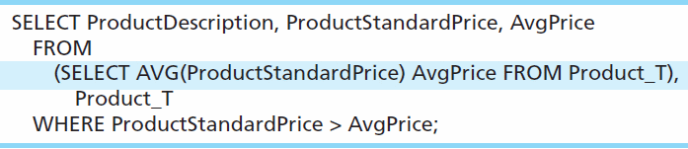
Another Subquery Example
Show all products whose standard price is higher than the average price
One column of the subquery is an aggregate function that has an alias name. That alias can then be referred to in the outer query
Subquery forms the derived table used in the FROM clause of the outer query
The WHERE clause normally cannot include aggregate functions, but because the aggregate is performed in the subquery its result can be used in the outer query’s WHERE clause
Notes:
In this query the subquery is in the FROM clause – this forms a derived table…
Average price is an alias of the aggregate function Now we can filter by it

Slide 30
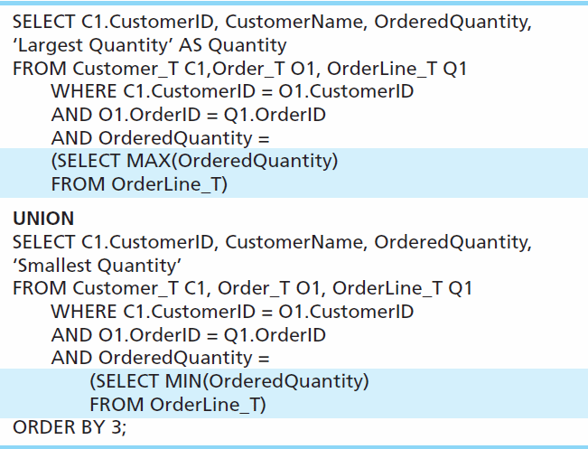
Union Queries
Combine the output (union of multiple queries) together into a single result table ( NO DUPS
First query
Combine
Second query
Notes:
UNION is used to combined output of multiple queries. Several times instead of writing one complicated query, it is easier and more readable to write two queries and combine the results.
That’s what union does

Slide 31
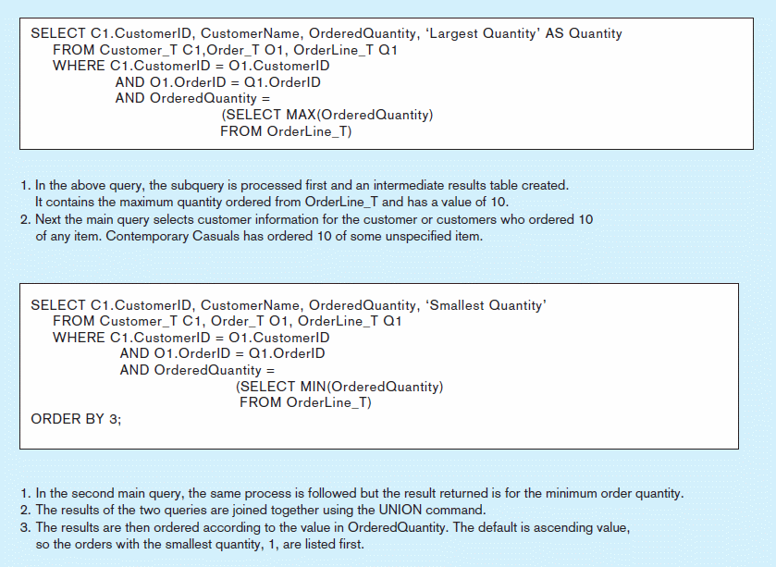
Figure 7-8 Combining queries using UNION
Note: with UNION queries, the quantity and data types of the attributes in the SELECT clauses of both queries must be identical
Notes:
When you union,
Data Types need to match, and the number of fields also have to match

Slide 32
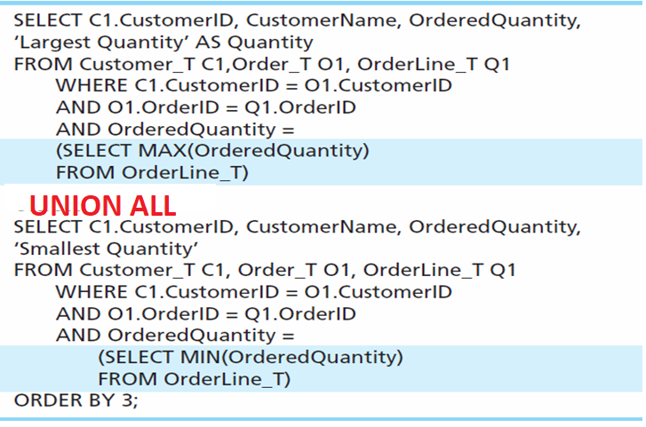
Union ALL Queries
Combine the output (union of multiple queries) together into a single result table ( WITH DUPS)
First query
Combine
Second query

Slide 33
Persistent Stored Module (PSM)
Persistent Stored Modules (SQL/PSM)
Capability to create and drop code modules
New statements:
CASE, IF, LOOP, FOR, WHILE, etc.
Makes SQL into a procedural language
Oracle has propriety version called PL/SQL, and Microsoft SQL Server has Transact/SQL

Slide 34
IF-THEN-ELSE logic in SQL
SELECT e.emp_fname, e.emp_lname, location AS City,
AS E when d.location ='London' THEN 'England' ELSE 'USA' END AS Country
FROM employee e JOIN department d ON e.dept_no = d.dept_no
WHERE CASE when d.location ='London' THEN 'England' ELSE 'USA' END =@Country
END

Slide 35
Routines and Triggers
Routines
Program modules that execute on demand
Functions–routines that return values and take input parameters
Procedures–routines that do not return values and can take input or output parameters
Triggers–routines that execute in response to a database event (INSERT, UPDATE, or DELETE)
Notes:
Routine is a block of code that does something, much like other programing languages such as java or C++
The tools available in those languages are also available in databases.
There is 3 basic types of routines in the database world:
Function, routine that takes input values and return values back
Stored procedures – returns that cannot return values but take input parameters
Triggers – routines that execute when an even occurs! For example a delete of a table

Slide 36
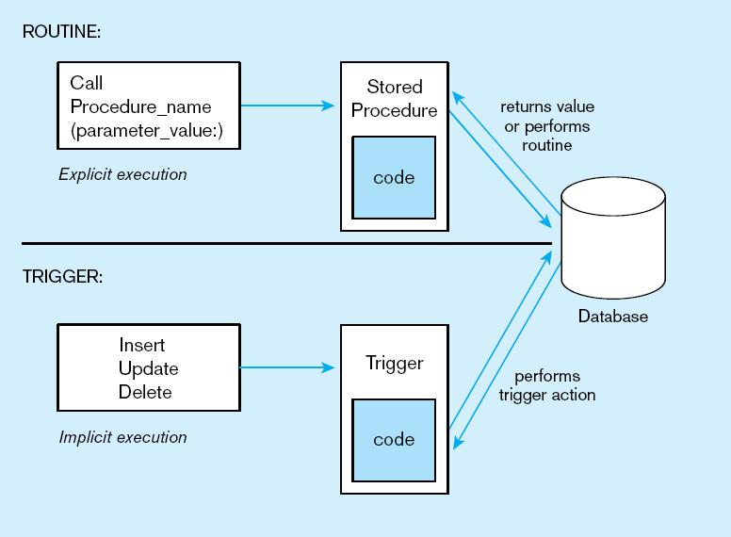
Figure7-11Triggers contrasted with stored procedures
Procedures are called explicitly
Triggers are event-driven
Source: adapted from Mullins, 1995.
Notes:
Procedures are called explicitly.
Functions are called when a DML statement is executed

Slide 37
Example of SQL Server Stored Procedures
CREAE PROCEDURE ChangeEmployeeDept @emp_no INT, @new_depar_no varchar(5)
AS
BEGIN
UPDATE employee set dept_no =@new_depar_no
WHERE emp_no = @emp_no
END
/*Executing the stored procedure */
EXEC ChangeEmployeeDept @emp_no= 15000, @new_depar_no='D1'
Notes:
ALTER PROCEDURE GetEmployees @depar_no varchar(5)
AS
BEGIN
SELECT * FROM employee
WHERE dept_no =@depar_no
END
EXEC GetEmployees 'D1’
ALTER PROCEDURE ChangeEmployeeDept @emp_no INT, @new_depar_no varchar(5)
AS
BEGIN
UPDATE employee set dept_no =@new_depar_no
WHERE emp_no = @emp_no
END
EXEC ChangeEmployeeDept 15000, 'D1’
EXEC ChangeEmployeeDept @emp_no= 15000, @new_depar_no='D1'

Slide 38
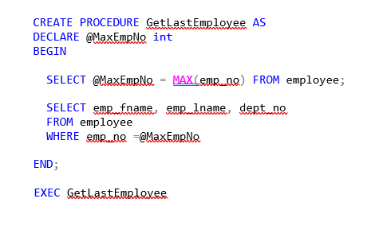
Procedure Example
can have multiple variables declarations
SELECT statement without being assigned to any object, results in result set returned by the PROC
Notes:
Stored procedure must have a name, it may have no input parameter, or no output parameter!
DECLARE block – for global variables that is valid throughout the whole procedure.

Slide 39
Stored Procedure with Output Parameter
CREATE PROCEDURE GetMinEmployee @MinEmployeeNo int OUTPUT
AS begin
select @MinEmployeeNo =min(emp_no)
from employee
end
/* How to Execute a stored proc with output parameter*/
declare @MinEmployeeNo int
EXEC GetMinEmployee @MinEmployeeNo output
select @MinEmployeeNo

Slide 40
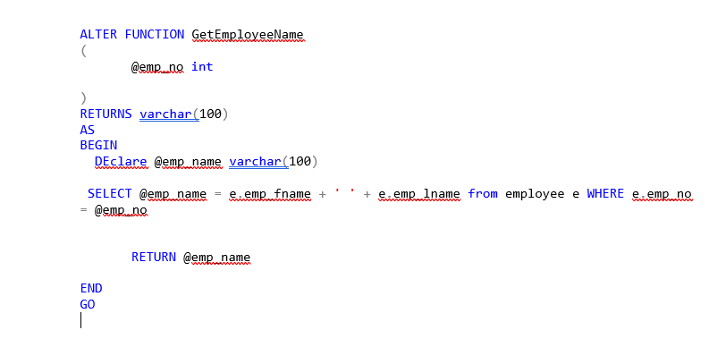
Function Example
Can have multiple input parameters
Last statement in a function is RETURN
Using Functions:
SELECT emp_no, dbo.GetEmployeeName(emp_no) AS EmployeeFullName
FROM employee

Slide 41
Triggers
Triggers – procedural code that is fired automatically when events occur in the database.
Triggers cannot be invoked directly
Trigger are associated with events such as DML commands such as UPDATE, DELETE, INSERT

Slide 42
Data Warehouse
Data Warehouse
A subject-oriented, integrated, time-variant, non-updatable collection of data used in support of management decision-making processes
Subject-oriented: e.g. customers, patients, students, products
Integrated: consistent naming conventions, formats, encoding structures; from multiple data sources
Time-variant: can study trends and changes
Non-updatable: read-only, periodically refreshed
Data Mart
A data warehouse that is limited in scope
Notes:
DW - a large DB store to guide management decisions.
is a system used for reporting and data analysis, and is considered a core component of business intelligence.
Data mart -A data warehouse that is limited in scope
Unlike operational system, DW is subject oriented to make useful for decision makers.
Integrated – different sources, info needs to be integrated, same naming convention
Time is important -> analysis of trends of time. To predict the future you must understand the past

Slide 43
Separating Operational and Informational Systems
Operational system – a system that is used to run a business in real time, based on current data; also called a system of record
Informational system – a system designed to support decision making based on historical point-in-time and prediction data for complex queries or data-mining applications
Datawarehouse = informational system
Notes:
They way operational systems are build, they are build to be the system of record, and run the operations.
Informational systems is designed to support decision making

Slide 44
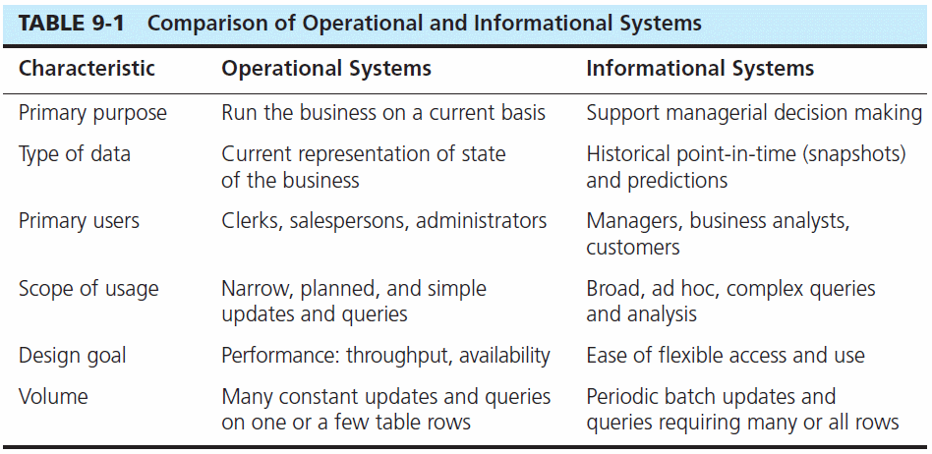

Slide 45
Benefits of Triggers
Data integrity checking
Auditing and logging
Derived column generation

Slide 46
Types of Triggers
AFTER UPDATE
AFTER DELETE
AFTER INSERT
BEFORE UPDATE
BEFORE DELETE
BEFORE INSERT
INSTEAD OF TRIGGER
DMBS skips the DML executed.

Slide 47
Concurrency Control
If concurrent transactions with interleaving operations are allowed in an uncontrolled manner such as:
The lost update problem
The dirty read problem
Non-repeatable read
Phantom read
Notes:
Many transactions in a database performing different operations at the same time. Without control we can have these 4 problems
This means you can not run a business on a DBMS because you cannot trust the data integrity and consistency

Slide 48
Transaction
BEGIN TRANSACTION
insert into department ( dept_no, dept_name)
values ( 'D6', 'Support')
SAVE TRANSACTION a
insert into department ( dept_no, dept_name)
values ( 'D7', 'Research')
SAVE TRANSACTION b
insert into department ( dept_no, dept_name)
values ( 'D8', 'Management')
ROLLBACK TRANSACTION b
insert into department ( dept_no, dept_name)
values ( ‘D9', 'Sales')
ROLLBACK TRANSACTION a
COMMIT TRANSACTION;

Slide 49
Properties of Transactions
set of properties of database transactions intended to guarantee validity even in the even in the event of errors
ACID Properties:
Atomicity
Consistency
Isolation
Durability
Notes:
The goal of ACID properties to guarantee the data integrity and validity when failures occurs.
What kind of failures: power outages, network outages, errors resulting from a dived by zero operation.
The ACID property is satisfied by what is called a TRANSACTION –single logical operation of the data.

Slide 50

Locking
To prevent problems in the pessimistic concurrency model, every DBMS must have mechanisms that control the access of data by all users at the same time.
Locking has several different aspects:
Lock duration
Lock modes
Lock granularity
Notes:
Concurrency can lead to several negative effects, such as the reading of nonexistent data or loss of modified data. Consider this real-world
example illustrating one of these.
Dirty reads: provide an example of address change.
Lock duration ( how long to hold the lock for, depends on isolation levels)
Lock modes ( what type of lock is being set exclusive, shared)
Lock granularity ( on a row, a page, a table, or a db)

Slide 51
Locking
To prevent problems in the pessimistic concurrency model, every DBMS must have mechanisms that control the access of data by all users at the same time.
Locking has several different aspects:
Lock duration
Lock modes
Lock granularity
Notes:
Concurrency can lead to several negative effects, such as the reading of nonexistent data or loss of modified data. Consider this real-world
example illustrating one of these.
Dirty reads: provide an example of address change.
Lock duration ( how long to hold the lock for, depends on isolation levels)
Lock modes ( what type of lock is being set exclusive, shared)
Lock granularity ( on a row, a page, a table, or a db)

Slide 52
Isolation Levels
Pessimistic model
READ UNCOMMITTED
REPEATABLE READ
SERIALIZABLE
Optimistic model
SNAPSHOT
Both models
READ COMMITTED
ISOLATION LEVELS
Notes:
Using isolation levels, you can specify which of the concurrency problems discussed in the preceding section may occur and which you want to avoid.

Slide 53
Exam Format
40 Questions
All multiple choice and True-or-False Questions
Conceptual questions
SQL based questions
Will be conducted via the Blackboard
Timed exam: 60 minutes

Slide 54
Questions breakdown
Difficulty Level | Number of Question | Points
Easier ( 2 pts each) | 25 | 50
Medium (3 points each) | 10 | 30
Difficult (4 points each) | 5 | 20
 | Total | 100

